Slide 1
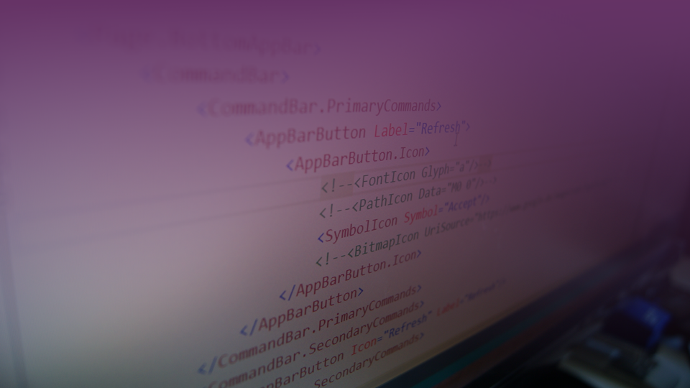
Text… überall nur Text Die dunkle Wahrheit über Strings im .NET Bereich
Ing. Christian Giesswein, MSc.
www.software.tirol

Slide 2








About Me
Ing. Christian Giesswein, MSc.
www.software.tirol
christian@software.tirol
Consulting, Training und Entwicklung
Technologisch am Puls der Zeit
Services & Technologien von Microsoft
C#, ASP.NET, WCF, WPF, ADO.NET, Entity Framework..
Desktopentwicklung
Datenbankentwicklung
Cloudentwicklung

Slide 3
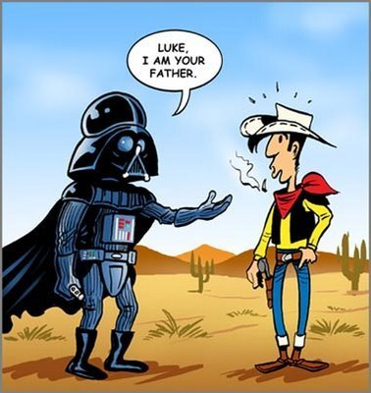
Die nächsten 60 Minuten,..

Slide 4
Ein String
Problemstellung:
Binär einen Text darstellen
H | A | L | L | O
72 | 79 | 108 | 108 | 111

Slide 5


Slide 6
Best-Practices
DO: Use StringComparison.Ordinal or OrdinalIgnoreCase for comparisons as your safe default for culture-agnostic string matching.
DO: Use StringComparison.Ordinal and OrdinalIgnoreCase comparisons for increased speed.
DO: Use StringComparison.CurrentCulture-based string operations when displaying the output to the user.
DO: Switch current use of string operations based on the invariant culture to use the non-linguistic StringComparison.Ordinal or StringComparison.OrdinalIgnoreCase when the comparison is linguistically irrelevant (symbolic, for example).
DO: Use ToUpperInvariant rather than ToLowerInvariant when normalizing strings for comparison.
DON'T: Use overloads for string operations that don't explicitly or implicitly specify the string comparison mechanism.
DON'T: Use StringComparison.InvariantCulture-based string operations in most cases; one of the few exceptions would be persisting linguistically meaningful but culturally-agnostic data.
Quelle: https://msdn.microsoft.com/en-us/library/ms973919.aspx

Slide 7
Fundamentals
Compare Performance
Culture
Immutable
Tooling:
String Interpolation / String.Format()
StringBuilder
String.Join(), String.Concat()
Unter Motorhaube
ILDASM App.exe /text | findstr ldstr
WinDbg !strings

Slide 8

Kontakt
Telefon: +43 / 664 46 36 135
Email: christian@software.tirol
Web: www.software.tirol
Interesse an: Technologieschulungen, Workshops, Couching, Architekturreview, Performanceanalyse… ? Sprechen Sie mich an!

